Slide 1
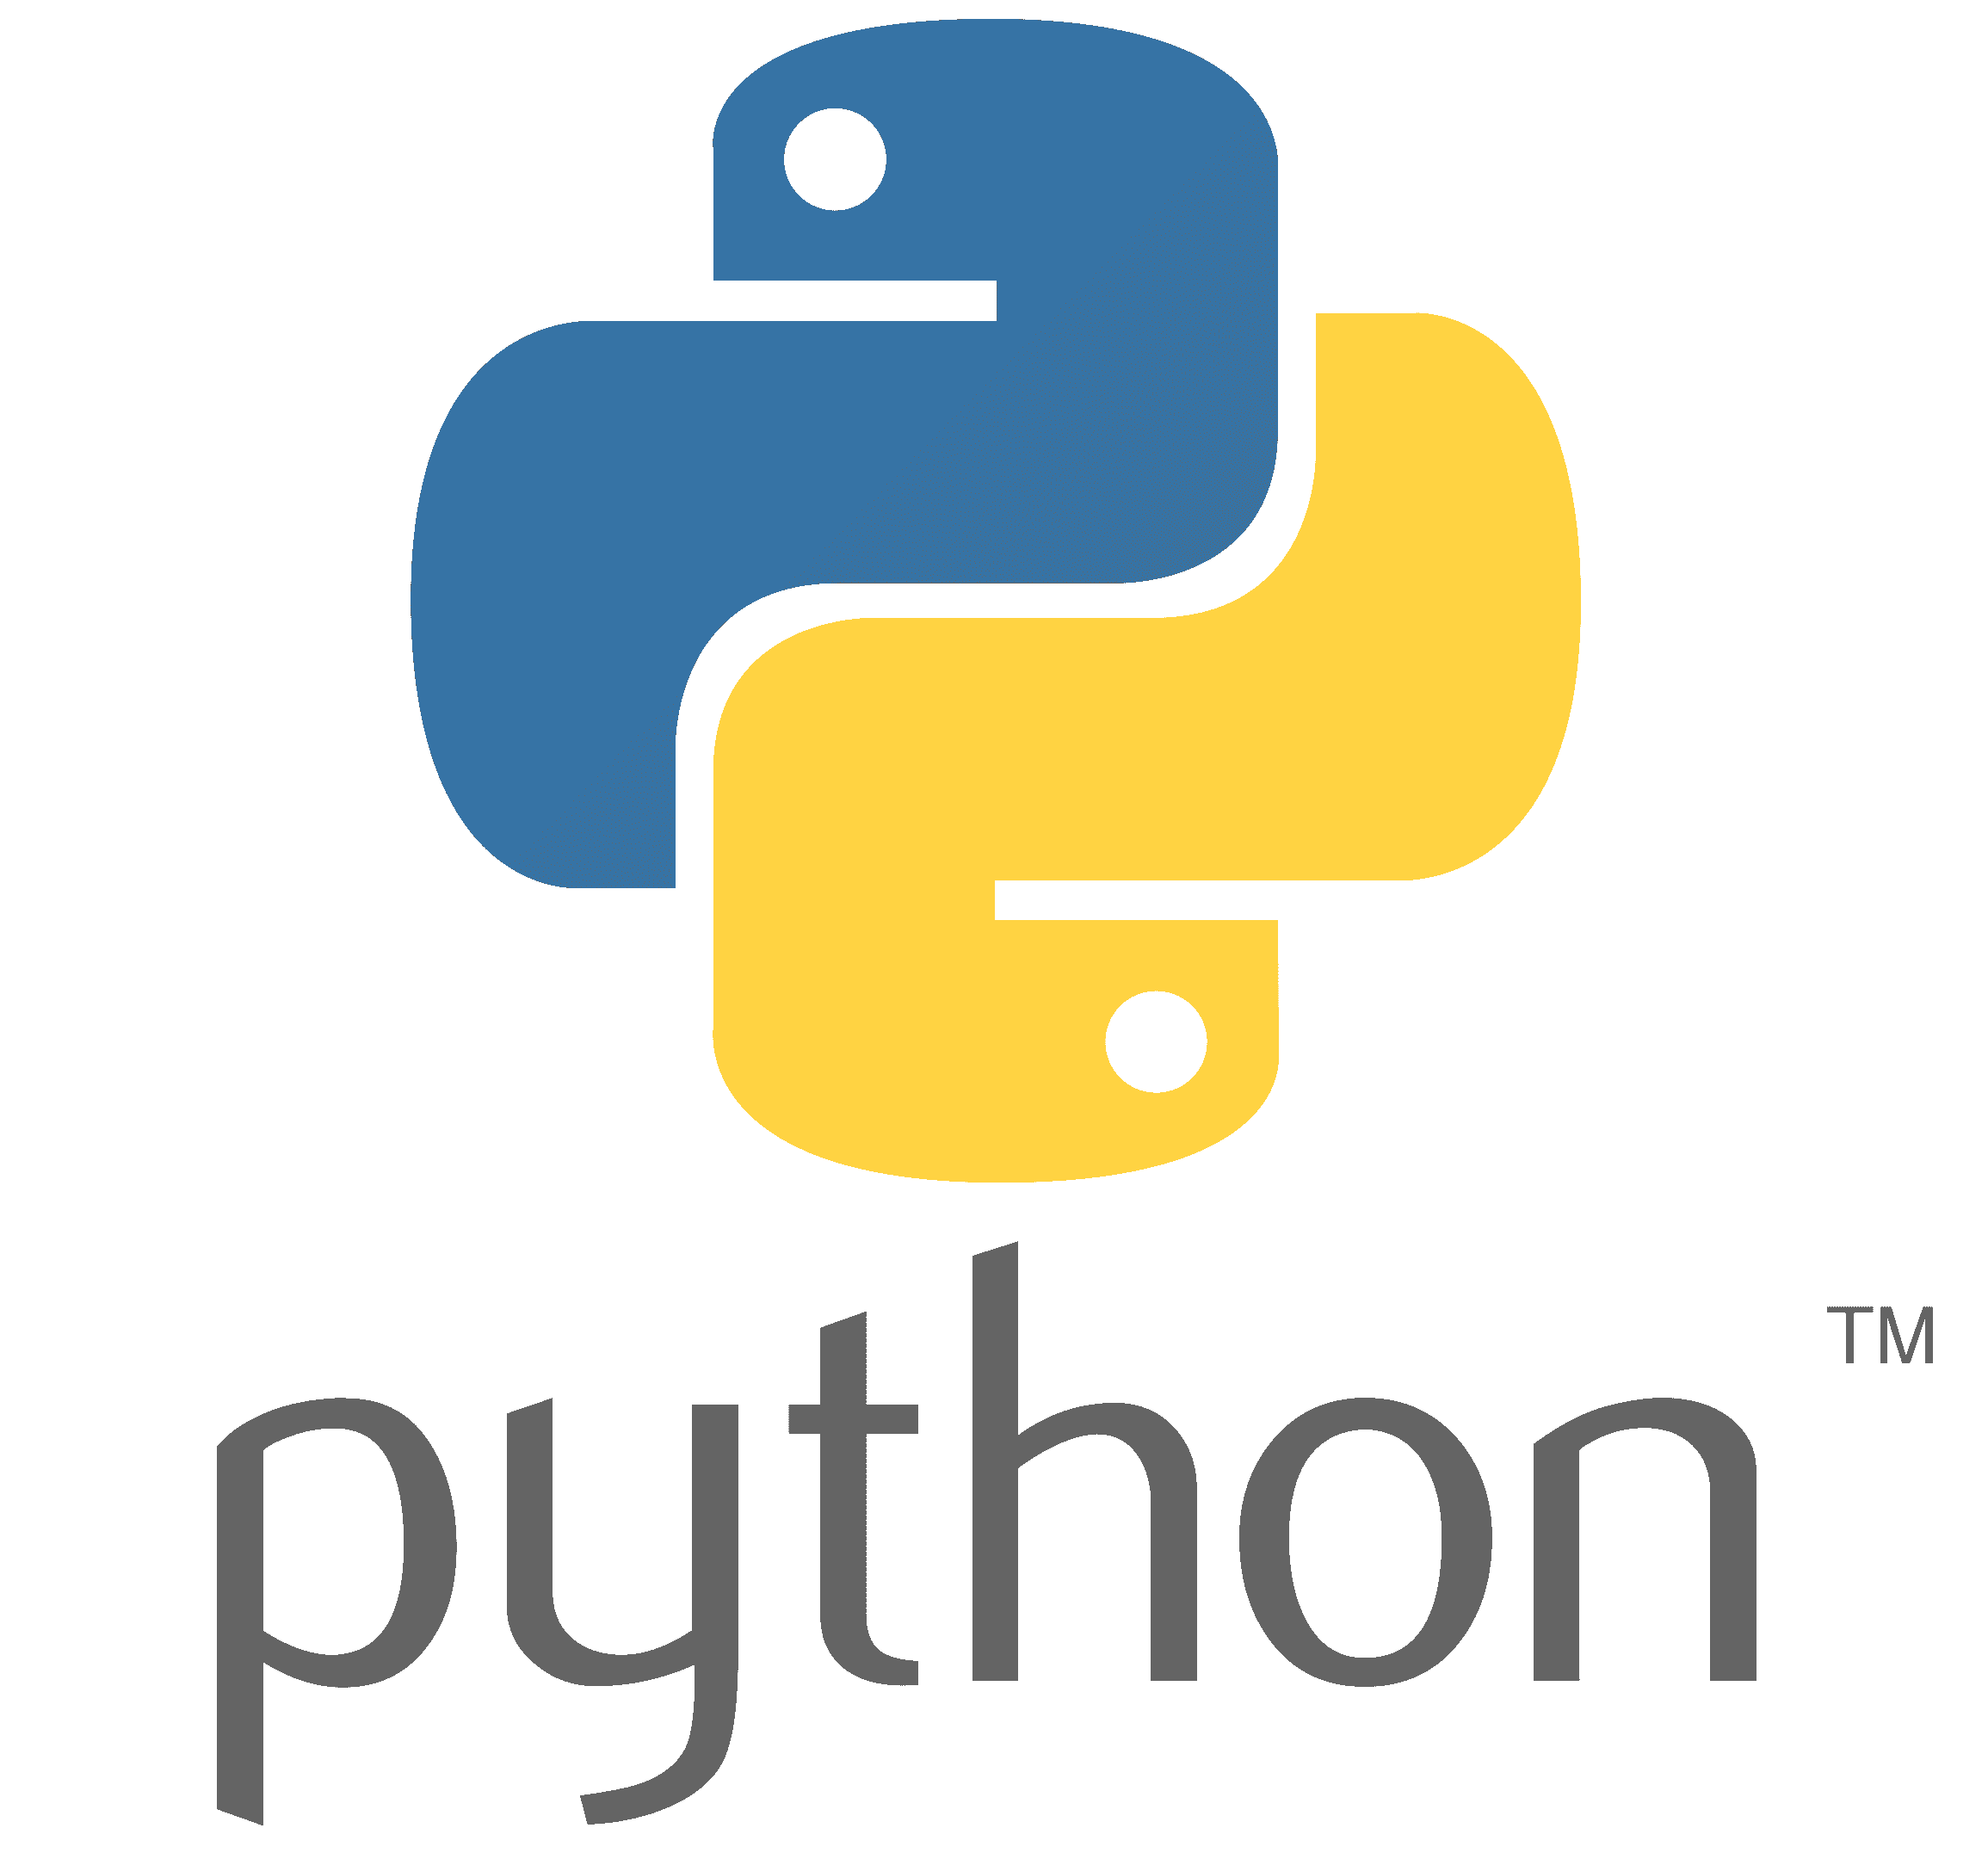
Python
Python
présenté par : Nouamane Lahlal - Karim Lahlou

Slide 2
Table of contents
01
05
02
06
03
07
04
08
What is python?
Variables
Lists
09
The Basics
String
Dictionaries
10
Data Types
Operators
Sets
11
Python Terms
Conditional
Statements
Tuples
12
Loops
Numpy Library
Pandas Library
13
14
15

Slide 3
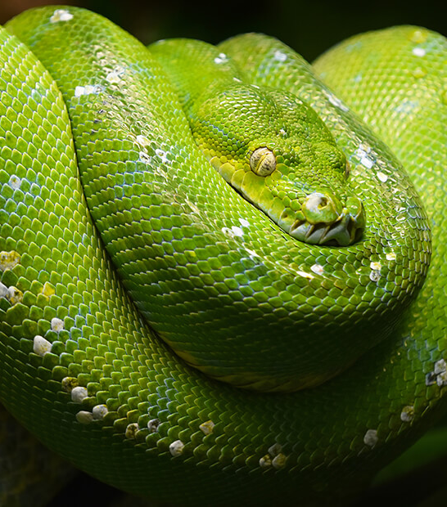
What is Python?
Python can refer to a family of nonvenomous snakes or a popular, high-level, general-purpose programming language
--------
Pythonidae is the scientific family name for the group of nonvenomous, constricting snakes commonly known as pythons

Slide 4
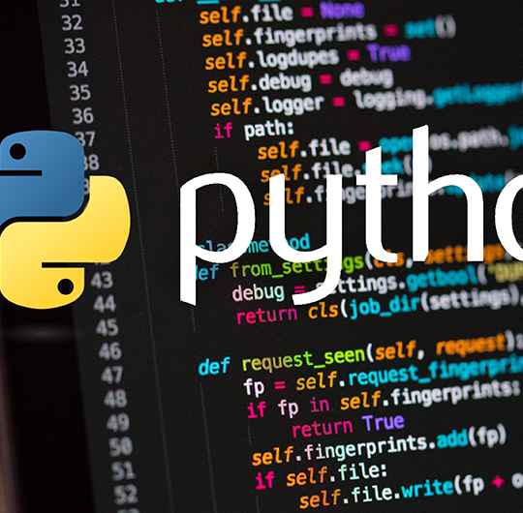
What is Python?
01
The language that conquered the world!

Slide 5
What is it exactly?
Python 🐍 is a high-level, interpreted, general-purpose programming language known for its simplicity, readability, and versatility. It supports multiple programming paradigms — including object-oriented, procedural, and functional programming — making it suitable for a wide range of applications, from simple scripts to complex machine learning systems.

Slide 6
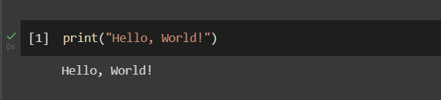
Key characteristics of Python:
Interpreted: Code is executed line by line by an interpreter,
not compiled before execution.
High-level: Abstracts complex details like memory management.
Dynamically typed: Variable types are determined at runtime.
Extensible: Can be integrated with languages like C, C++, or Java.
Cross-platform: Runs on most operating systems (Windows, macOS, Linux, etc.).
Open-source: Freely available with a massive community and ecosystem.

Slide 7
Python is used in fields such as:
01
02
03
Data Science & Machine Learning (with libraries like NumPy, Pandas, TensorFlow)
Web Development (Django, Flask)
Automation & Scripting
04
05
06
Cybersecurity
Game Development
Software Testing
07
Artificial Intelligence

Slide 8
The Evolution Of Python
Late 1980s
1991
1994
2008
2010s
Guido van Rossum began designing Python at the Netherlands’ CWI (Centrum Wiskunde & Informatica) as a successor to the ABC language, aiming for simplicity and power.
Python 0.9.0 released
The first public version, including features like functions, exception handling, and modules.
Python 1.0
Added functional tools like map(), filter(), lambda, and error handling improvements.
Python 3.0
A complete redesign for long-term stability and clarity. It was not backward-compatible with Python 2, improving syntax consistency and Unicode handling.
Rise in popularity
Python became dominant in education, data analysis, and AI due to libraries like NumPy, Pandas, and TensorFlow.

Slide 9
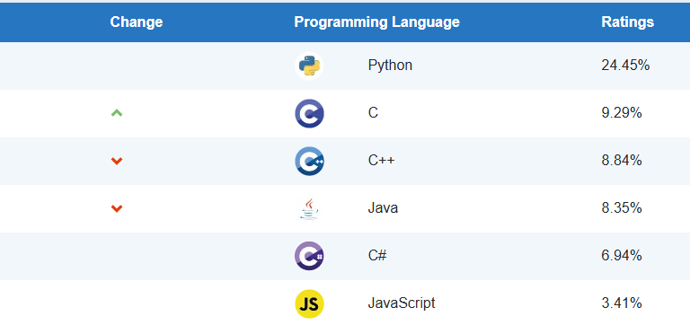
As of oct 2025, python is the most famous programming languages
Write your Name
Source : TIOBE

Slide 10
Python Famous Libraries :
🧮 1. NumPy
Sert à manipuler des tableaux numériques (n-dimensional arrays) et à effectuer des calculs mathématiques rapides et efficaces.
🗂️ 2. Pandas
Permet de manipuler, nettoyer et analyser des données tabulaires (DataFrame) de manière simple et intuitive.
📈 3. Matplotlib
Librairie de base pour créer des graphiques (lignes, barres, histogrammes, etc.) en Python.
🎨 4. Seaborn
Basée sur Matplotlib, elle simplifie la création de visualisations statistiques esthétiques et claires.
🧠 5. Scikit-learn
Utilisée pour le machine learning : classification, régression, clustering, réduction de dimension, etc.
🧰 6. SciPy
Fournit des outils avancés pour les calculs scientifiques, l’algèbre linéaire, les statistiques et l’optimisation.

Slide 11
Where can we use Python:
Environment | Type | Works On | Key Use | Needs Installation
Jupyter Notebook | Local / Web | Desktop | Interactive coding, visualization | ✅
JupyterLab | Local / Web | Desktop | Advanced multi-file projects | ✅
Google Colab | Cloud | Browser | Free cloud notebooks with GPU | ❌
Kaggle Notebooks | Cloud | Browser | ML & data competitions | ❌
Spyder | Desktop IDE | Anaconda | Scientific development | ✅

Slide 12
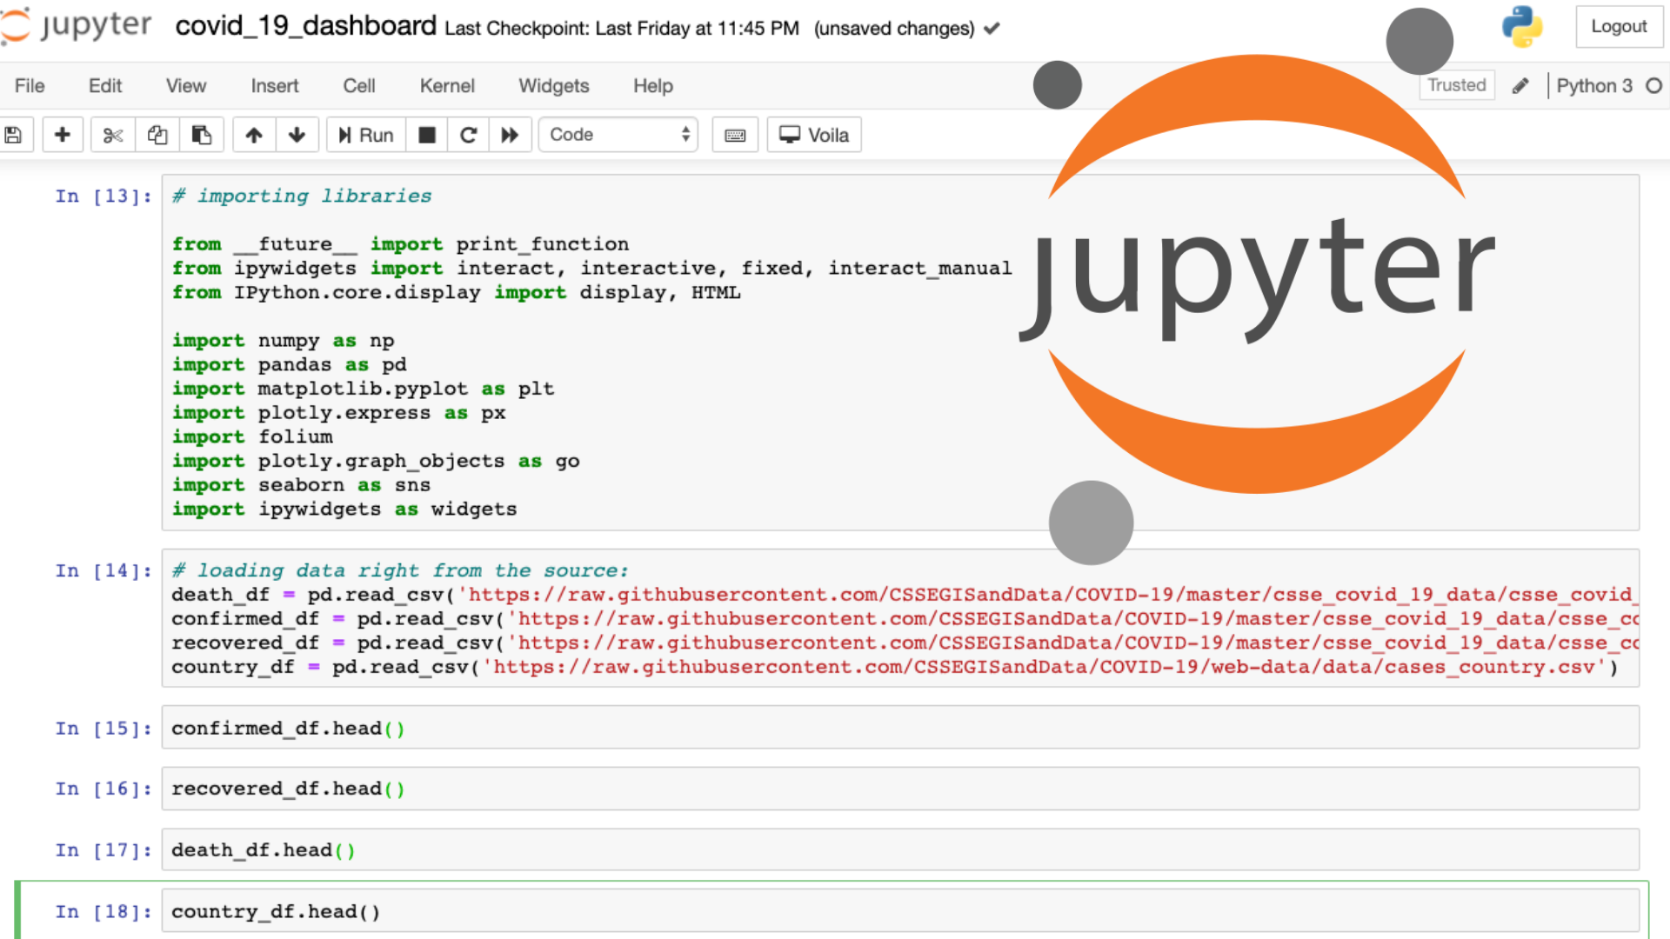
Jupyter Notebook
Famous libraries
JupyterLab is the latest web-based interactive development environment for notebooks, code, and data. Its flexible interface allows users to configure and arrange workflows in data science, scientific computing, computational journalism, and machine learning.
It allows data scientists to create and share documents that include live code, equations, and other multimedia resources.

Slide 13
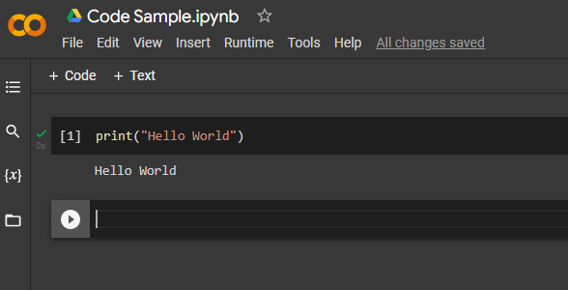
Google Colab
Famous libraries
Colab is a hosted Jupyter Notebook service that requires no setup to use and provides free access to computing resources, including GPUs and TPUs.

Slide 14
The Basics
02
Let’s teach you to walk on your feet!

Slide 15
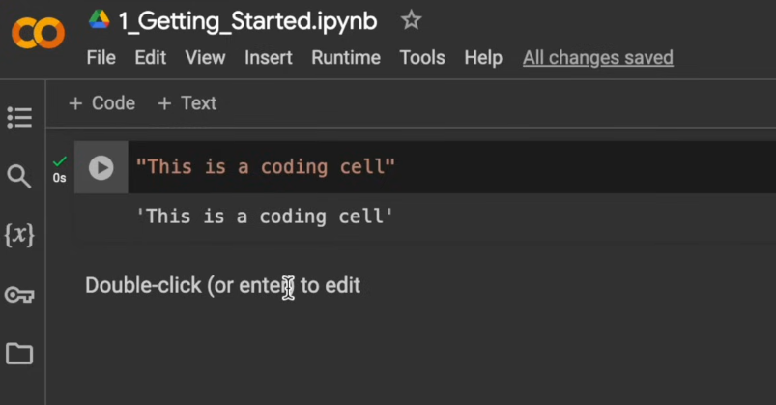
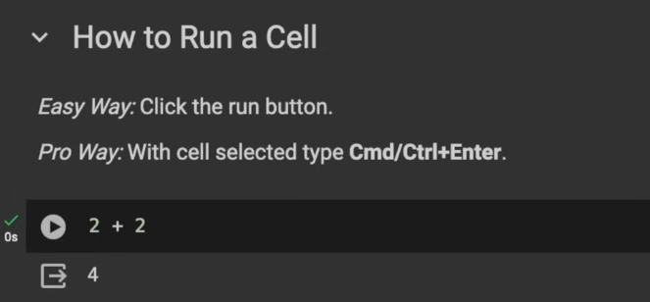
First Steps
You can add a code and a text cell,
For example :
“this is a coding cell”
It will print :
‘This is a coding cell’
Or
2 + 2
4

Slide 16
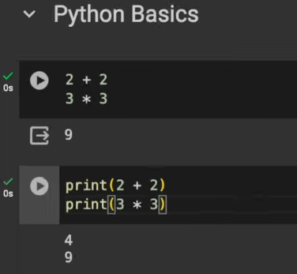
Use Print
You can use print, to print each elements, instead of writing raw mathematical functions which will end up no showing some of your values.
Use print() for each math operation.

Slide 17
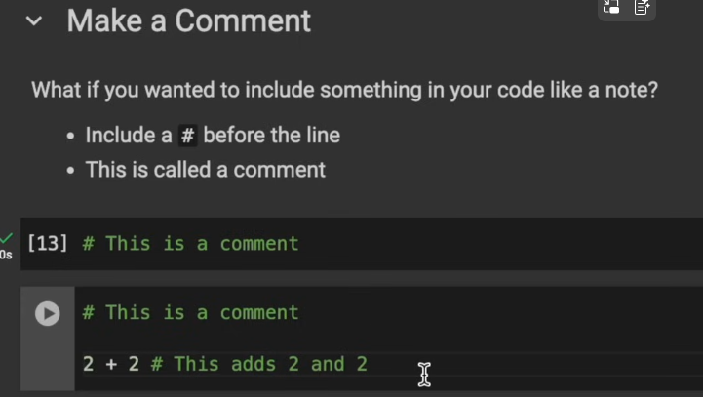
Making comments
Comments are good for coding, you can use them to let some of your nerdy friends knows what you did on your code, this allows for complete comprehension of the whole coding operation.
2+2 # this is a comment

Slide 18
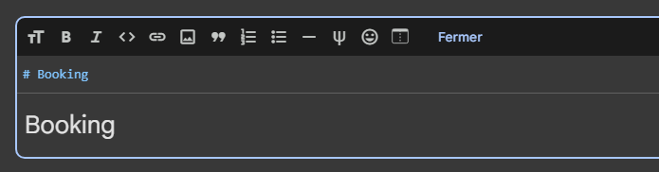
Markdown
Markdown in Google Colab is a lightweight formatting language used to add text, headings, lists, links, and images inside your notebook — just like in Jupyter Notebook.
Example :
# Booking
Booking

Slide 19
Data Types
03
Data types of python

Slide 20
Data types
Text Type
Numeric Types
Type | Example | Description
str | name = "Alice" | Sequence of characters (text)
Type | Example | Description
int | x = 10 | Integer numbers (no decimals)
float | y = 3.14 | Floating-point numbers (decimals)
complex | z = 2 + 3j | Complex numbers with real and imaginary parts
Boolean Type
Type | Example | Description
bool | flag = True | True or False values
Sequence Types
Mapping Types
Type | Example
list | lst = [1, 2, 3]
tuple | tup = (1, 2, 3)
range | r = range(5)
Type | Example
dict | d = {"name":"Alice", "age":25}

Slide 21
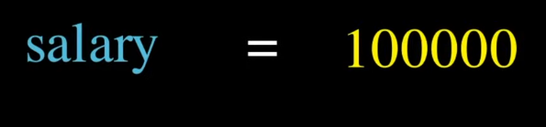
Python Terms
04
Methods, attributes, functions, etc

Slide 22
Python Terms
Term | What it is | Example
Variable | Stores data | x = 10
Object | Instance of a class / data with type | [1, 2, 3], "hello"
Function | Block of reusable code | def add(a,b): return a+b
Class | Blueprint for creating objects | class Car:
Method | Function inside a class | def start(self):
Attribute | Data inside an object | self.color = "red"

Slide 23
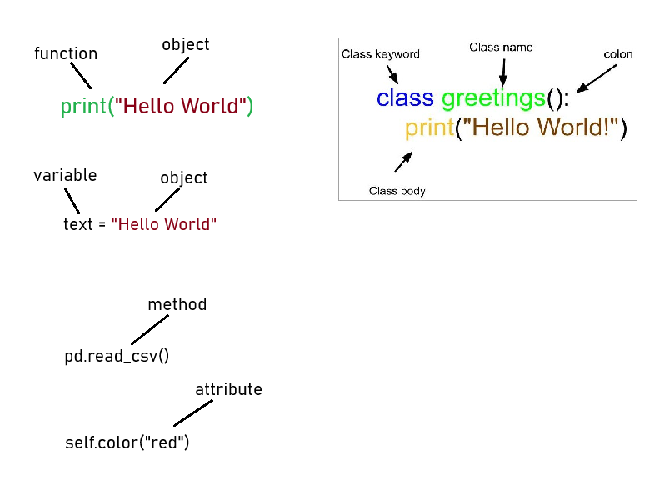
Python Terms

Slide 24
Variables
05
The most fundamental concept in python

Slide 25
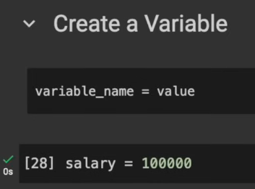
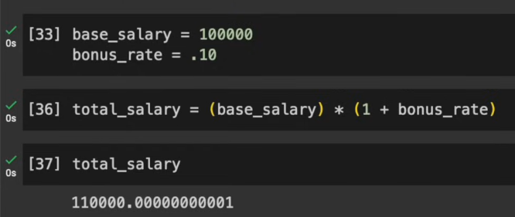
Variables
A variable in Python is a name that stores a value in memory — like a label for data.

Slide 26
String
06
All text types

Slide 27

String
In Python, a string is a sequence of characters enclosed in quotes
Some string methods :
.replace()
.len()
.lower()
.upper()

Slide 28
Operators
07
Math!!

Slide 29
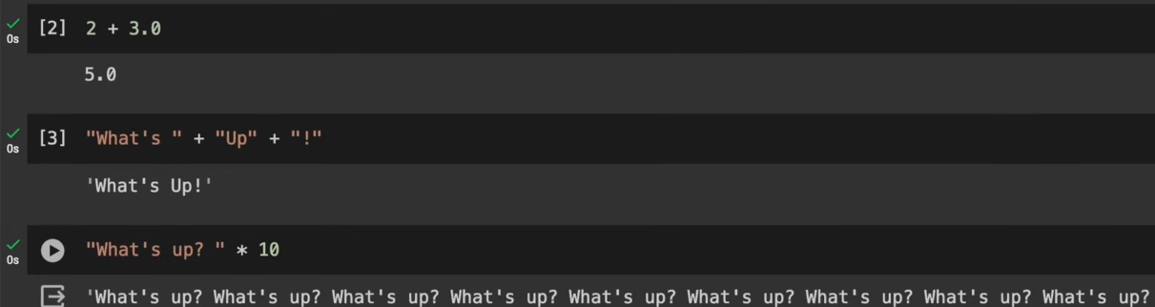
Operators
Operators in Python are symbols that let you manipulate data, compare values, and control logic in expressions and programs.
Type | Example | Description
Arithmetic | + - * / % // ** | Perform math operations
Assignment | = += -= *= /= | Assign or update values
Comparison | == != > < >= <= | Compare two values

Slide 30
Conditional Statements
08
If, elif, else

Slide 31
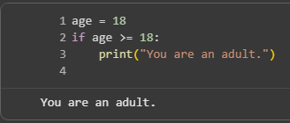
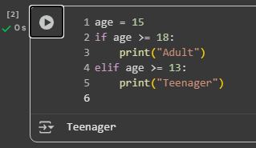
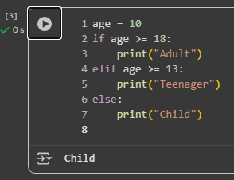
Conditional Statements
In Python, if, elif, and else are conditional statements used to make decisions in your program.
The if condition
The elif condition
The else condition

Slide 32
Lists
09
Just a list

Slide 33
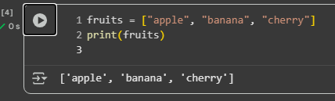
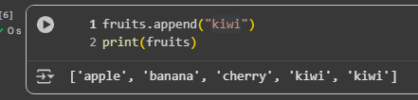
Lists
A list is a sequence of elements enclosed in square brackets [ ], separated by commas.
You can use methods to modify a list, ex: adding an object

Slide 34
Dictionaries
10
Read a dictionary…

Slide 35
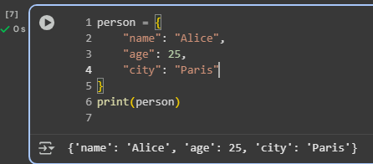
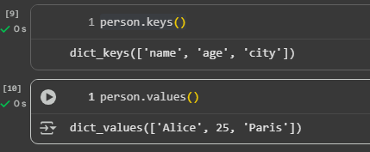
Dictionaries
A dictionary is an unordered, changeable (mutable) data type that stores data in key–value pairs, written inside curly braces { }.
You can also use methods to view keys, and values of your dictionary

Slide 36
- Sets
12
Sets.

Slide 37
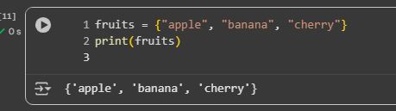
Sets
A set is a collection of unique, unordered, and unindexed elements enclosed in curly braces { }.
Common Operations
Operation | Example | Result
Add item | fruits.add("orange") | adds "orange"
Remove item | fruits.remove("apple") | removes "apple"
Length | len(fruits) | number of elements
Clear | fruits.clear() | empties the set

Slide 38
Tuples
13
Triples!

Slide 39
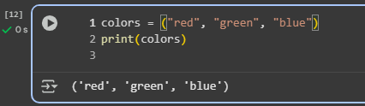
Tuples
In Python, a tuple is an ordered and immutable collection of items.
It’s similar to a list, but you can’t change (add, remove, or modify) its elements after it’s created.
Common Operations
Operation | Example | Result
Length | len(colors) | 3
Count occurrences | colors.count("red") | 1
Find index | colors.index("green") | 1
Combine | new = colors + ("yellow",) | new tuple

Slide 40
Loops
14
loopy

Slide 41
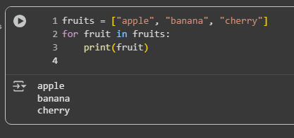
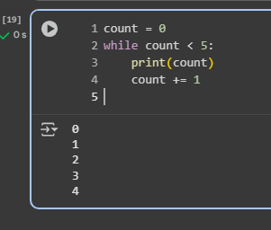
Loops
a loop is a way to repeat a block of code multiple times without writing it over and over. Loops are useful when you want to perform the same action for a set of items, until a condition is met, or a certain number of times.
for loop
repeats code for each item in a sequence
while loop
repeats code as long as a condition is true.

Slide 42
NumPy Library
15
The mathematical library

Slide 43
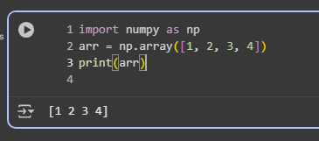
NumPy Library
NumPy (short for Numerical Python) is a fundamental library in Python for numerical computing and data manipulation. It is widely used in data science, machine learning, and scientific computing because it makes working with numbers fast and efficient.

Slide 44
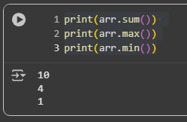
NumPy Mathemaical calculations
NumPy has built-in functions for mean, sum, max, min, sine, cosine, and many more.

Slide 45
Pandas Library
15
Black & White

Slide 46
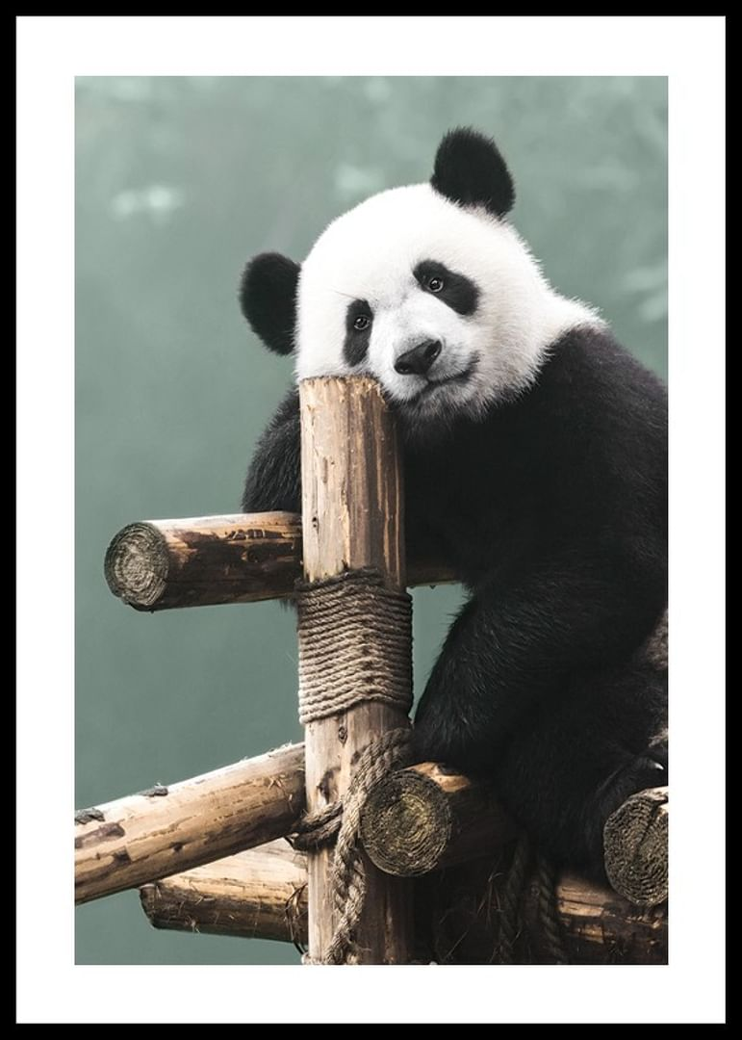

Slide 47
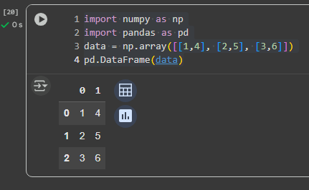
Pandas Library
I think we meant Pandas (not the animal 🐼), which is a Python library widely used for data analysis and manipulation.
Pandas makes it easy to read, clean, transform, and analyze data.
Works best with tabular data (like Excel spreadsheets, CSV files, SQL tables).
You can combine NumPy and Pandas to create libraries like this

Slide 48
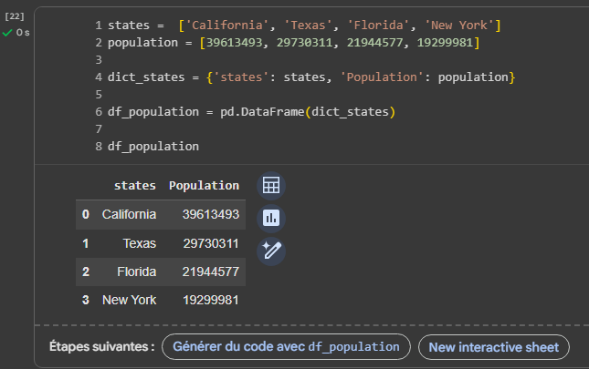
Pandas Library
Converting a dictionary to DataFrame

Slide 49
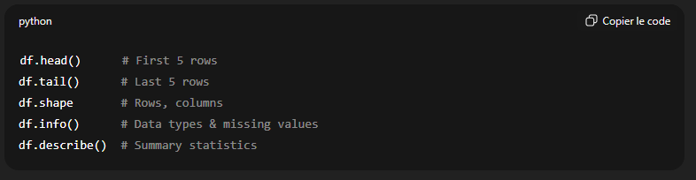
Some Important Pandas Methods

Slide 50
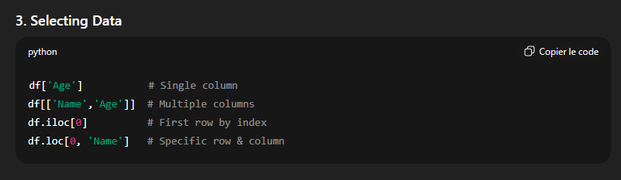
Some Important Pandas Methods

Slide 51
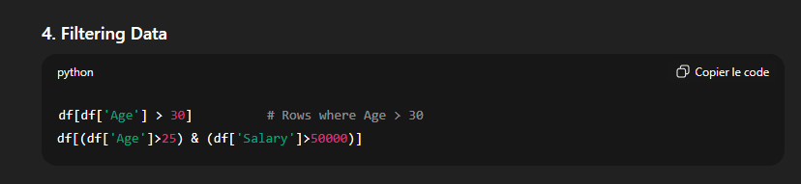
Some Important Pandas Methods

Slide 52
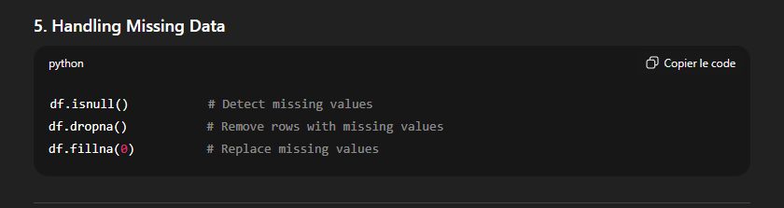
Some Important Pandas Methods

Slide 53
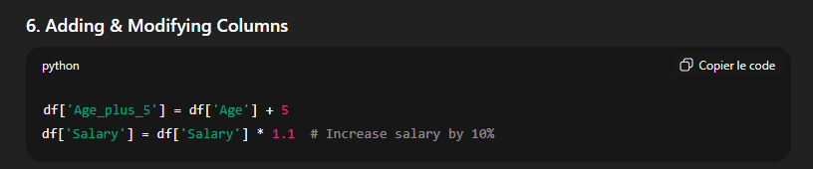
Some Important Pandas Methods

Slide 54
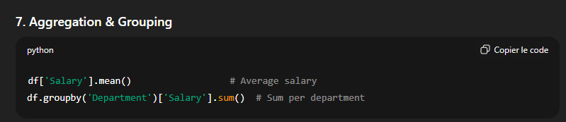
Some Important Pandas Methods

Slide 55
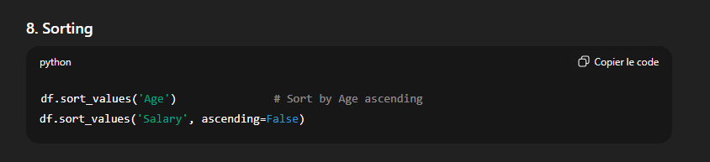
Some Important Pandas Methods

Slide 56
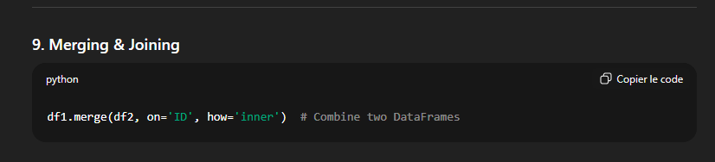
Some Important Pandas Methods

Slide 57
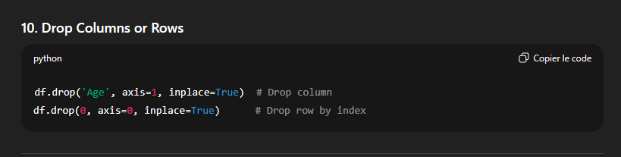
Some Important Pandas Methods

Slide 58
< Thank you >

